Slide 1
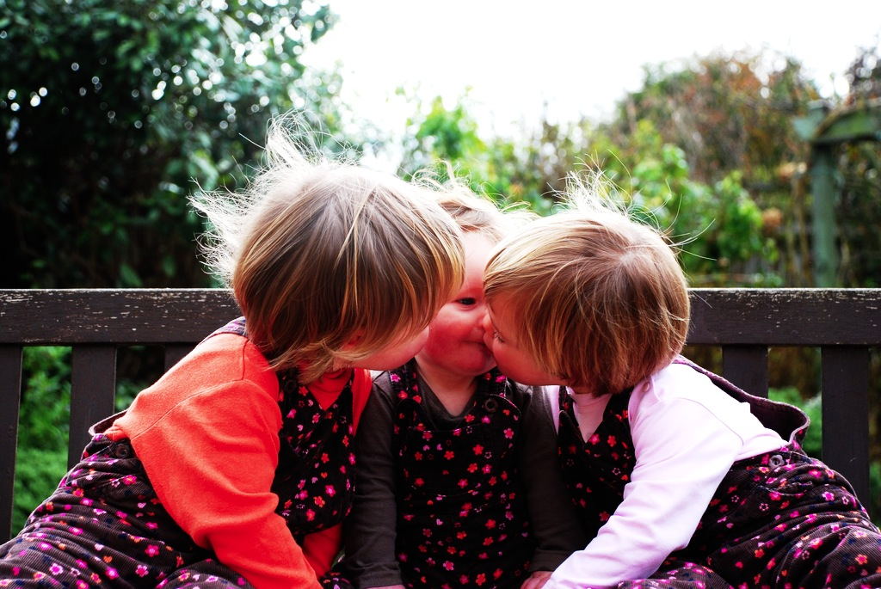

Intention and
Motor Representation
in Joint Action

Slide 2
joint action
Notes:
Where should we start thinking about joint action? Psychologists standard examples include ...

Slide 3
tidying up the toys together
(Behne et al 2005)
cooperatively pulling handles in sequence to make a dog-puppet sing
(Brownell et al 2006)
bouncing a ball on a large trampoline together
(Tomasello & Carpenter 2007)
pretending to row a boat together
Notes:
Two challenges : (1) fit intuitive category; (2) explain the contrast cases

Slide 4
painting a house together
(Bratman 1992)
lifting a heavy sofa together
(Velleman 1997)
preparing a hollandaise sauce together
(Searle 1990)
going to Chicago together
(Kutz 2000)
walking together
(Gilbert 1990)
tidying up the toys together
(Behne et al 2005)
cooperatively pulling handles in sequence to make a dog-puppet sing
(Brownell et al 2006)
bouncing a ball on a large trampoline together
(Tomasello & Carpenter 2007)
pretending to row a boat together
Notes:
These anchor our understanding of what joint action is.

Slide 5
Joint
Not joint
Notes:
In introducing joint action philosophers sometimes use contrast cases, pairs of actions which are similar in terms of behaviour and coordination but where one is joint but the other isn’t.

Slide 6
Joint
Not joint
Jack and Sue walk together
Jack and Sue walk alongside each other
(Gilbert 1990)

Slide 7
Joint
Not joint
Jack and Sue walk together
Jack and Sue walk alongside each other
(Gilbert 1990)
We collectively perform a dance by running to a shelter at the same time
We each individually run to a shelter at the same time (in response to a sudden shower).
(Searle 1990, 92)
Notes:
These sorts of contrast case invite the question, How do joint actions differ from individual actions which may occur in parallel? What is the difference between Jack & Sue walking together and their walking side-by-side? Gilbert’s example shows that the difference can’t just be a matter of coordination, because people merely walking alongside each other also need to coordinate their actions in order to avoid colliding with each other. And Searle’s example shows that the difference between joint action and parallel individual action can’t just be that the actions have a common effect because merely parallel actions can have common effects too.

Slide 8
exoticism
Notes:
So how does a joint action involving two or more agents differ from an event comprising the merely parallel actions of those agents?
In answering this most philosophers endorse exoticism.
Exoticism is the thesis that distinctive ingredients are needed to characterise joint action, ingredients which are not needed to characterise ordinary individual action.

Slide 9
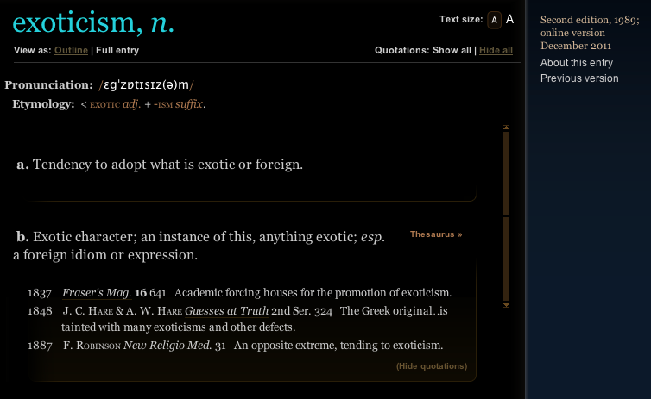
exoticism
Notes:
So how does a joint action involving two or more agents differ from an event comprising the merely parallel actions of those agents?
In answering this most philosophers endorse exoticism.
Exoticism is the thesis that distinctive ingredients are needed to characterise joint action, ingredients which are not needed to characterise ordinary individual action.

Slide 10
‘The key question in the philosophy of collective action is simply ... under what conditions are two or more people doing something together?’
(Gilbert 2010: 67)
Notes:
Exoticism about joint action is so widely assumed that it is often implicit ...

Slide 11
‘The key question in the philosophy of collective action is simply ... under what conditions are two or more people doing something together?’
(Gilbert 2010: 67)
Notes:
the assumption that there is a philosophy of action is like the assumption that there is a philosophy of feline action ...
Why think that there are two separate questions:
- under what conditions is a single agent doing something?
- under what conditions are two or more agents doing something together?

Slide 12
shared
intention
(or ’collective’)
Notes:
Exoticism very often takes the form of a belief that shared intention is necessary for joint action.
Shared intention is the exotic ingredient in joint action, the thing not needed for characterising ordinary, individual action but whose presence distinguishes cases of joint action from cases of merely parallel action.
It’s hard to say what shared intention is, but I think one thing everyone agrees about is this: shared intention is to joint action what ordinary individual intention is to ordinary, individual action.

Slide 13
‘I take a collective action to involve a collective [shared] intention.’
(Gilbert 2006, p. 5)
Notes:
so MG says ...

Slide 14
‘I take a collective action to involve a collective [shared] intention.’
(Gilbert 2006, p. 5)
‘The sine qua non of collaborative action is a joint goal [shared intention] and a joint commitment’
(Tomasello 2008, p. 181)

Slide 15
‘I take a collective action to involve a collective [shared] intention.’
(Gilbert 2006, p. 5)
‘The sine qua non of collaborative action is a joint goal [shared intention] and a joint commitment’
(Tomasello 2008, p. 181)
‘the key property of joint action lies in its internal component [...] in the participants’ having a “collective” or “shared” intention.’
(Alonso 2009, pp. 444-5)
‘Shared intentionality is the foundation upon which joint action is built.’
(Carpenter 2009, p. 381)
Notes:
What is wrong with this widely held view?
I think there are three reasons for resisting it.
One is simply that the notion of shared intention is problematic: there seem to be as many different accounts of shared intention as there are philosophers who have discussed it (and yes I am working on an account of shared intention of my very own, of course).
[see next page] A second is that the parallel move in the case of individual action is at least questionable
[see next page] Third is that we should avoid exoticism generally ...

Slide 16
Do all actions involve intentions? No.
Notes:
Does every action involve an intention?
This is a tricky question because in some cases the term ‘intention’ is used just for a strongest desire.
But if we don’t use ‘intention’ in that way, if we suppose that a strongest desire is not necessarily an intention, then there is reason to suppose that some actions do not involve any intentions.
Let me explain.
Consider an agent who has beliefs and desires and no other kind of propositional attitude. When the agent faces a choice, its beliefs determine what it thinks the outcomes of each choice will be and how probable each of these outcomes will be given the choices it makes. And its desires determine how strongly it prefers one outcome over another. The agent then acts by selecting an option that is not less likely than any other option to realised a preferred outcome.
This agent acts and her actions are purposive but her actions are driven entirely by beliefs and desires, not by intentions at all.
It is striking that two philosophers with the most detailed, rigorous theories about intention allow for the possibility of actions which are purposive and driven by beliefs and desire but not intentions, Velleman and Bratman.
On either theory, it is reasonable to suppose that many of our own everyday actions do not involve intention.
I am hungry, I have an overwhelming desire for a sandwich and I believe that there is one in your hand.
When you offer me the sandwich, I take it.
Not because I have any intention, but simply because this is what my beliefs and desires dispose me to do.
There is simply no need, in this sort of case, to suppose that I am acting on any intention at all.
OK, I know that there are people here who have different views, who have developed Searle’s idea that there are intentions in action.
I am sceptical that there is any need for intentions in action

Slide 17
1. Spontaneous actions are intentional.
2. Spontaneous actions do not involve acting on intentions acquired prior to acting.
3. An agent who does something intentionally is acting on an intention.
Notes:
I suppose that if you accept all three of these claims, then you might well want to disagree with me about whether all actions involve intentions.
But I think that at least two of these three claims are doubtful ...

Slide 18
1. Spontaneous actions are intentional.
2. Spontaneous actions do not involve acting on intentions acquired prior to acting.
3. An agent who does something intentionally is acting on an intention.
Notes:
And it seems to me that if we reject these claims then we should also reject the claim that all purposive actions involve intentions.

Slide 19
Do all actions involve intentions? No. Maybe not.
Notes:
OK, so maybe we will disagree about this.
But look, suppose I am right.
On my view---like on Bratman’s or Velleman’s---intentions are essential where you need to plan multiple actions (***illustration with putting ball in bucket) or where you need a sophisticated form of self-understanding. They aren’t essential merely for acting, for taking a sandwich or for running for a bus.
If this is right, not all ordinary, individual actions involve intention.
But then, if shared intentions are supposed to stand to joint actions as ordinary, individual intentions stand to ordinary, individual actions, then it surely can’t be the case that all joint actions involve shared intentions.
But if there are joint actions without shared intention, then we can’t appeal to shared intention to explain how joint actions differ from merely parallel actions.
So the second reason for rejecting the view that all joint actions involve shared intentions is just the thought that it seems implausible given that not all actions involve intentions.

Slide 20
exoticism
Notes:
The third reason for rejecting the claim that all joint actions involve shared intention is what will in effect occupy me in the rest of the talk.
The claim that all joint actions involve shared intention is a form of exoticism.
An in philosophy it is better to avoid exoticism if we can ... that is, it is better to have a theory which doesn’t require exotic ingredients.
So if I can show that there is a way of characterising joint action without appeal to exotic ingredients, I will have given a reason for supposing that no such ingredients are necessary.

Slide 21
Joint action:
an action with two or more agents (Ludwig 2007)
Notes:
Ludwig's picture is really beautiful:
1. joint actions are actions with multiple agents
2. shared intentions are intentions on the part of each of us that we perform a joint action.
The joint-ness is not in the intention but in the action, and this greatly simplifies the account of shared intention that we need.
This is a beautiful illustration of anti-exoticism about joint action.
The view characterises joint action as merely action.
On this view there really is no such thing as the `philosophy of collective action'.
But unfortunately this is wrong ...
In what follows I want, first, to explain why it is wrong.
I then want to show how taking seriously the possibility that some actions involve social motor representations would enable us to fix the view.
So the idea will be that we can avoid exoticism about joint action but only by recognising that motor representation plays a role in explaining what joint action is.

Slide 22
Joint action:
an action with two or more agents (Ludwig 2007)

Slide 23
Joint action:
an action with two or more agents (Ludwig 2007)
‘our primitive actions, the ones we do not by doing something else, ... these are all the actions there are.’ (Davidson 1971, p. 59).

Slide 24
Joint action:
an action with two or more agents (Ludwig 2007)
‘our primitive actions, the ones we do not by doing something else, ... these are all the actions there are.’ (Davidson 1971, p. 59).
move fingers
unlock door
turn key

Slide 25
Joint action:
an action with two or more agents (Ludwig 2007)
‘our primitive actions, the ones we do not by doing something else, ... these are all the actions there are.’ (Davidson 1971, p. 59).
move fingers
unlock door
turn key

Slide 26
Joint action:
an action with two or more agents (Ludwig 2007)
‘our primitive actions, the ones we do not by doing something else, ... these are all the actions there are.’ (Davidson 1971, p. 59).
move fingers
unlock door
turn key

Slide 27
Joint action:
an action with two or more agents (Ludwig 2007)
‘our primitive actions, the ones we do not by doing something else, ... these are all the actions there are.’ (Davidson 1971, p. 59).
tidying up the toys together
(Behne et al 2005)
cooperatively pulling handles in sequence to make a dog-puppet sing
(Brownell et al 2006)
bouncing a ball on a large trampoline together
(Tomasello & Carpenter 2007)
pretending to row a boat together
move fingers
unlock door
turn key

Slide 28
Joint action:
an action with two or more agents (Ludwig 2007)
‘our primitive actions, the ones we do not by doing something else, ... these are all the actions there are.’ (Davidson 1971, p. 59).
tidying up the toys together
(Behne et al 2005)
cooperatively pulling handles in sequence to make a dog-puppet sing
(Brownell et al 2006)
bouncing a ball on a large trampoline together
(Tomasello & Carpenter 2007)
pretending to row a boat together
move fingers
unlock door
turn key

Slide 29
Joint action:
an action with two or more agents (Ludwig 2007)
tidying up the toys together
(Behne et al 2005)
cooperatively pulling handles in sequence to make a dog-puppet sing
(Brownell et al 2006)
bouncing a ball on a large trampoline together
(Tomasello & Carpenter 2007)
pretending to row a boat together
my pulling
dog’s singing
your pulling
We make the dog sing

Slide 30
Joint action:
an action with two or more agents (Ludwig 2007)
tidying up the toys together
(Behne et al 2005)
cooperatively pulling handles in sequence to make a dog-puppet sing
(Brownell et al 2006)
bouncing a ball on a large trampoline together
(Tomasello & Carpenter 2007)
pretending to row a boat together
my pulling
dog’s singing
your pulling
We make the dog sing

Slide 31
1
Joint action:
an action with two or more agents (Ludwig 2007)
Bodily movements ‘are all the actions there are’ (Davidson 1971, p. 59)
In supposedly paradigm cases of joint action, there are no bodily movements with more than one agent.
Therefore:
Supposedly paradigm cases are not joint actions.
tidying up the toys together
(Behne et al 2005)
cooperatively pulling handles in sequence to make a dog-puppet sing
(Brownell et al 2006)
bouncing a ball on a large trampoline together
(Tomasello & Carpenter 2007)
pretending to row a boat together
2
3
4

Slide 32
1
too narrow
Joint action:
an action with two or more agents (Ludwig 2007)
Bodily movements ‘are all the actions there are’ (Davidson 1971, p. 59)
In supposedly paradigm cases of joint action, there are no bodily movements with more than one agent.
Therefore:
Supposedly paradigm cases are not joint actions.
tidying up the toys together
(Behne et al 2005)
cooperatively pulling handles in sequence to make a dog-puppet sing
(Brownell et al 2006)
bouncing a ball on a large trampoline together
(Tomasello & Carpenter 2007)
pretending to row a boat together
2
3
4

Slide 33
?
1
too narrow
Joint action:
an action with two or more agents (Ludwig 2007)
Bodily movements ‘are all the actions there are’ (Davidson 1971, p. 59)
In supposedly paradigm cases of joint action, there are no bodily movements with more than one agent.
Therefore:
Supposedly paradigm cases are not joint actions.
tidying up the toys together
(Behne et al 2005)
cooperatively pulling handles in sequence to make a dog-puppet sing
(Brownell et al 2006)
bouncing a ball on a large trampoline together
(Tomasello & Carpenter 2007)
pretending to row a boat together
2
3
4

Slide 34
?
1
too narrow
Joint action:
an action with two or more agents (Ludwig 2007)
Bodily movements ‘are all the actions there are’ (Davidson 1971, p. 59)
In supposedly paradigm cases of joint action, there are no bodily movements with more than one agent.
Therefore:
Supposedly paradigm cases are not joint actions.
tidying up the toys together
(Behne et al 2005)
cooperatively pulling handles in sequence to make a dog-puppet sing
(Brownell et al 2006)
bouncing a ball on a large trampoline together
(Tomasello & Carpenter 2007)
pretending to row a boat together
2
3
4
Notes:
we could reject this ... but I want to pursue a different approach

Slide 35
1
too narrow
Joint action:
an action with two or more agents (Ludwig 2007)
Bodily movements ‘are all the actions there are’ (Davidson 1971, p. 59)
In supposedly paradigm cases of joint action, there are no bodily movements with more than one agent.
Therefore:
Supposedly paradigm cases are not joint actions.
tidying up the toys together
(Behne et al 2005)
cooperatively pulling handles in sequence to make a dog-puppet sing
(Brownell et al 2006)
bouncing a ball on a large trampoline together
(Tomasello & Carpenter 2007)
pretending to row a boat together
2
3
4
Notes:
we could reject this ... but I want to pursue a different approach

Slide 36
Joint action:
an action with two or more agents (Ludwig 2007)

Slide 37
Joint action:
an action event with two or more agents (Ludwig 2007)

Slide 38
Grounding
events D₁, ... D_{n} ground E, if:
D₁, ... D_{n} and E occur;
D₁, ... D_{n} are each (perhaps improper) parts of E; and
every event that is a proper part of E but does not overlap D₁,...D_{n} is caused by some or all of D₁, ... D_{n}.
Agency
For an individual to be among the agents of an event is for there to be actions a₁, ... a_{n} which ground this event where the individual is an agent of one or more of these actions.
(Adapted from Pietroski 1998)

Slide 39
Joint action:
an action event with two or more agents (Ludwig 2007)

Slide 40
Joint action:
an action event with two or more agents (Ludwig 2007)
tidying up the toys together
(Behne et al 2005)
cooperatively pulling handles in sequence to make a dog-puppet sing
(Brownell et al 2006)
bouncing a ball on a large trampoline together
(Tomasello & Carpenter 2007)
pretending to row a boat together
my pulling
dog’s singing
your pulling
We make the dog sing

Slide 41
Joint action:
an action event with two or more agents (Ludwig 2007)
tidying up the toys together
(Behne et al 2005)
cooperatively pulling handles in sequence to make a dog-puppet sing
(Brownell et al 2006)
bouncing a ball on a large trampoline together
(Tomasello & Carpenter 2007)
pretending to row a boat together

Slide 42
Joint action:
an action event with two or more agents (Ludwig 2007)
tidying up the toys together
(Behne et al 2005)
cooperatively pulling handles in sequence to make a dog-puppet sing
(Brownell et al 2006)
bouncing a ball on a large trampoline together
(Tomasello & Carpenter 2007)
pretending to row a boat together
Nora’s shooting
Fred’s death
Olive’s shooting
Fred’s killing

Slide 43
too broad
Joint action:
an action event with two or more agents (Ludwig 2007)
tidying up the toys together
(Behne et al 2005)
cooperatively pulling handles in sequence to make a dog-puppet sing
(Brownell et al 2006)
bouncing a ball on a large trampoline together
(Tomasello & Carpenter 2007)
pretending to row a boat together
Nora’s shooting
Fred’s death
Olive’s shooting
Fred’s killing

Slide 44
too broad
Joint action:
an action event with two or more agents (Ludwig 2007)
tidying up the toys together
(Behne et al 2005)
cooperatively pulling handles in sequence to make a dog-puppet sing
(Brownell et al 2006)
bouncing a ball on a large trampoline together
(Tomasello & Carpenter 2007)
pretending to row a boat together
Nora’s shooting
Fred’s death
Olive’s shooting
Fred’s killing

Slide 45
Goal-directed joint action: an event with two or more agents which, taken as a whole, is directed to a goal.
tidying up the toys together
(Behne et al 2005)
cooperatively pulling handles in sequence to make a dog-puppet sing
(Brownell et al 2006)
bouncing a ball on a large trampoline together
(Tomasello & Carpenter 2007)
pretending to row a boat together
Nora’s shooting
Fred’s death
Olive’s shooting
Fred’s killing

Slide 46
Goal-directed joint action: an event with two or more agents which, taken as a whole, is directed to a goal.
tidying up the toys together
(Behne et al 2005)
cooperatively pulling handles in sequence to make a dog-puppet sing
(Brownell et al 2006)
bouncing a ball on a large trampoline together
(Tomasello & Carpenter 2007)
pretending to row a boat together
cooperatively pulling handles in sequence to make a dog-puppet sing
(Brownell et al 2006)
my pulling
dog’s singing
your pulling
We make the dog sing

Slide 47
Goal-directed joint action: an event with two or more agents which, taken as a whole, is directed to a goal.
out
out
act
out
act
out

Slide 48
Goal-directed joint action: an event with two or more agents which, taken as a whole, is directed to a goal.
out
out
act
represents
coordinates
out
act
shared intention
out

Slide 49
Goal-directed joint action: an event with two or more agents which, taken as a whole, is directed to a goal.
???
out
out
act
represents
coordinates
out
act
shared intention
out

Slide 50
Detour
Goals are not intentions

Slide 51
What is the relation between an action and the goal (or goals) to which it is directed?
out
out
act
out
out

Slide 52
What is the relation between an action and the goal (or goals) to which it is directed?
out
out
act
out
out

Slide 53
What is the relation between an action and the goal (or goals) to which it is directed?
out
out
act
out
intention or other goal-state
out

Slide 54
What is the relation between an action and the goal (or goals) to which it is directed?
teleological function
out
out
act
out
intention or other goal-state
out

Slide 55
(i) in the past, actions of this type have caused outcomes of this type; (ii) this action happens now in part because (i).
What is the relation between an action and the goal (or goals) to which it is directed?
teleological function
out
out
act
out
intention or other goal-state
out

Slide 56
(i) in the past, actions of this type have caused outcomes of this type; (ii) this action happens now in part because (i).
What is the relation between an action and the goal (or goals) to which it is directed?
teleological function
out
out
act
out
intention or other goal-state
It is possible to represent goal-directed actions without representing intentions.
out

Slide 57
End Detour

Slide 58
Goal-directed joint action: an event with two or more agents which, taken as a whole, is directed to a goal.
???
out
out
act
represents
coordinates
out
act
shared intention
out

Slide 59
Goal-directed joint action: an event with two or more agents which, taken as a whole, is directed to a goal.
G is a distributive goal: it is an outcome to which each agent’s activities are individually directed and it is possible that: all agents succeed relative to this outcome.

Slide 60
Goal-directed joint action: an event with two or more agents which, taken as a whole, is directed to a goal.
G is a distributive goal: it is an outcome to which each agent’s activities are individually directed and it is possible that: all agents succeed relative to this outcome.
G is a collective goal
(a) it is a distributive goal;
(b) the agents’ activities are coordinated; and
(c) coordination of this type would normally facilitate occurrences of outcomes of this type.

Slide 61
Goal-directed joint action: an event with two or more agents which, taken as a whole, is directed to a goal.
G is a distributive goal: it is an outcome to which each agent’s activities are individually directed and it is possible that: all agents succeed relative to this outcome.
G is a collective goal
(a) it is a distributive goal;
(b) the agents’ activities are coordinated; and
(c) coordination of this type would normally facilitate occurrences of outcomes of this type.

Slide 62
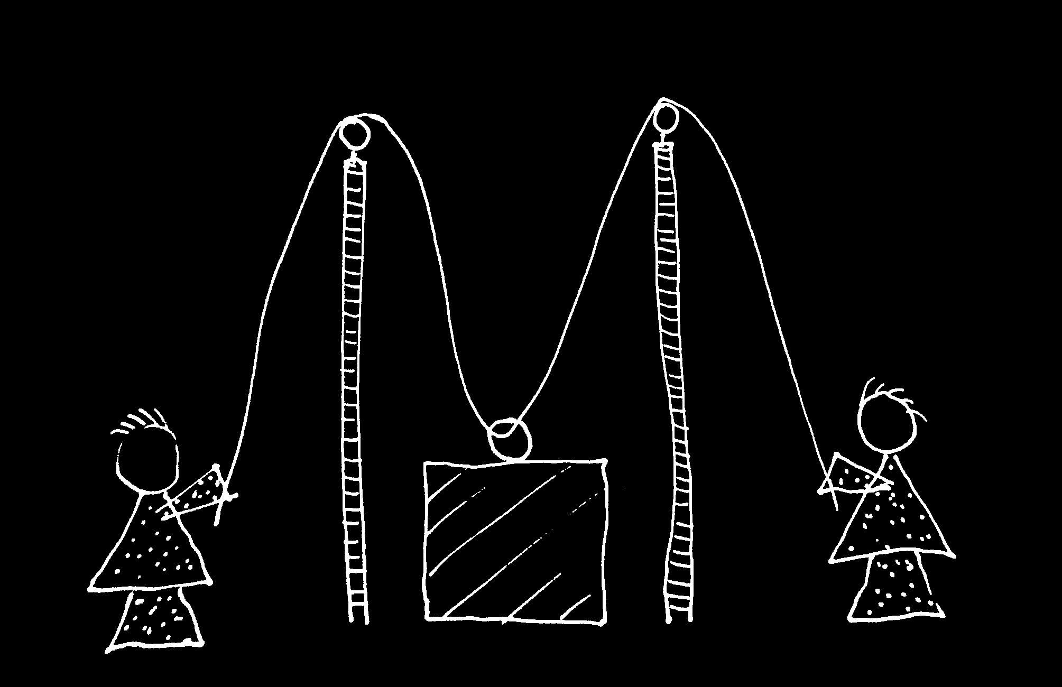

Slide 63


Slide 64
sting
sting
sting
sting
sting
death of fly
sting
sting
sting

Slide 65
Goal-directed joint action: an event with two or more agents which, taken as a whole, is directed to a goal.
G is a distributive goal: it is an outcome to which each agent’s activities are individually directed and it is possible that: all agents succeed relative to this outcome.
G is a collective goal
(a) it is a distributive goal;
(b) the agents’ activities are coordinated; and
(c) coordination of this type would normally facilitate occurrences of outcomes of this type.

Slide 66
Goal-directed joint action: an event with two or more agents which, taken as a whole, is directed to a goal.
G is a distributive goal: it is an outcome to which each agent’s activities are individually directed and it is possible that: all agents succeed relative to this outcome.
G is a shared goal
G is a collective goal
(a) it is a distributive goal;
(b) the agents’ activities are coordinated; and
(c) coordination of this type would normally facilitate occurrences of outcomes of this type.
Each agent expects each of the other agents to perform activities directed to the goal.
Each agent expects the goal to occur as a common effect of all their goal-directed actions.

Slide 67
Joint action:
an action event with two or more agents (Ludwig 2007)

Slide 68
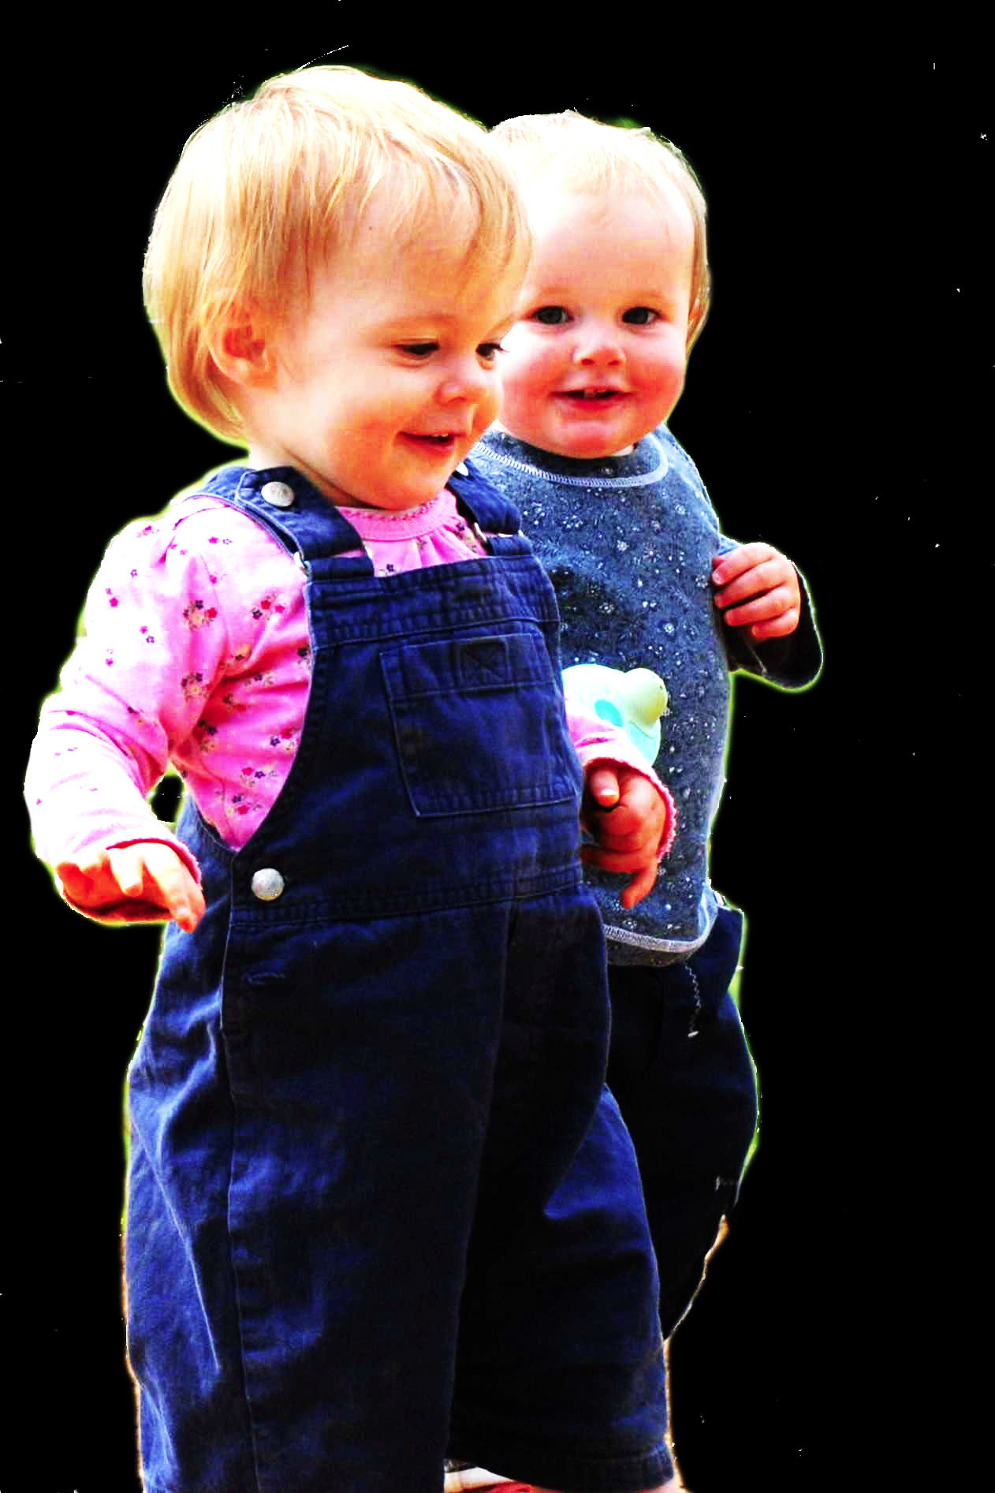
challenge
Explain the emergence, in evolution or development, of sophisticated forms of social cognition.
conjecture
The existence of abilities to engage in joint action partially explains how sophisticated forms of social cognition emerge in evolution or development (or both)
question
Given the conjecture, what could joint action be?

Slide 69
Goal-directed joint action: an event with two or more agents which, taken as a whole, is directed to a goal.
G is a distributive goal: it is an outcome to which each agent’s activities are individually directed and it is possible that: all agents succeed relative to this outcome.
G is a shared goal
G is a collective goal
(a) it is a distributive goal;
(b) the agents’ activities are coordinated; and
(c) coordination of this type would normally facilitate occurrences of outcomes of this type.
Each agent expects each of the other agents to perform activities directed to the goal.
Each agent expects the goal to occur as a common effect of all their goal-directed actions.

Slide 70


Slide 71

joint action &
knowing
others’
minds
Notes:
This is an overview of the project and its aims

Slide 72
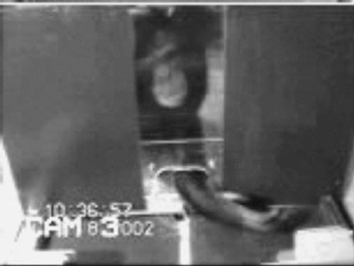
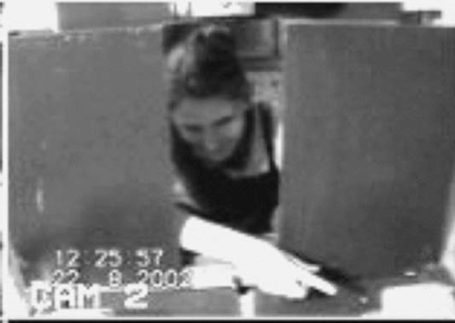
failed reach
point
source: Hare & Tomasello (2004)
Notes:
this illustrates problem of identifying particular goals of action

Slide 73
The problem of opaque means

Slide 74
The problem of false belief

Slide 75
your-goal-is-my-goal

Slide 76
your-goal-is-my-goal
1. We are about to engage in some joint action* or other
2. I am not about to change my goal.
Therefore:
3. Your actions also will be directed to this goal.
[*in at least the minimal sense associated with distributive goals]

Slide 77
failed reach
point
source: Hare & Tomasello (2004)

Slide 78
failed reach
point
source: Hare & Tomasello (2004)
“to understand pointing, the subject needs to understand more than the individual goal-directed behaviour. She needs to understand that ... the other attempts to communicate to her ... and ... the communicative intention behind the gesture”
(Moll & Tomsello 2007)

Slide 79
failed reach
point
source: Hare & Tomasello (2004)
“to understand pointing, the subject needs to understand more than the individual goal-directed behaviour. She needs to understand that ... the other attempts to communicate to her ... and ... the communicative intention behind the gesture”
(Moll & Tomsello 2007)

Slide 80
Csibra’s ‘two stances’:
Teleological and referential action interpretation ‘rely on different kinds of action understanding’
These are initially two distinct ‘action interpretation systems’ and they come together later in development
Csibra (2003, p. 456)

Slide 81
minimal theory of mind cognition
joint action (ability to share goals)
understanding communicative intent
other stuff
communication by language
other stuff
full-blown theory of mind cognition

Slide 83
Joint action:
an event with two or more agents (Ludwig 2007)
Goal-directed joint action:
a joint action which, taken as a whole, is directed to a goal
Nora’s shooting
Fred’s death
Olive’s shooting
Fred’s killing

Slide 84
What is the relation between an action and the goal (or goals) to which it is directed?

Slide 85
What is the relation between an action and the goal (or goals) to which it is directed?

Slide 86
What is the relation between an action and the goal (or goals) to which it is directed?
out
out
act
out
out

Slide 87
What is the relation between an action and the goal (or goals) to which it is directed?
out
out
act
(goal)
out
out

Slide 88
What is the relation between an action and the goal (or goals) to which it is directed?
out
out
act
represents
coordinates
(goal)
out
intention or other goal-state
out

Slide 89
What is the relation between an action and the goal (or goals) to which it is directed?
teleological function
out
out
act
represents
coordinates
out
intention or other goal-state
out

Slide 90
What is the relation between an action and the goal (or goals) to which it is directed?
teleological function
out
out
act
represents
coordinates
out
intention or other goal-state
It is possible to represent goal-directed actions without representing intentions.
out

Slide 91
out
out
act
out
out

Slide 92
Goal-directed joint action: an event with two or more agents which, taken as a whole, is directed to a goal.
out
out
act
out
out

Slide 94
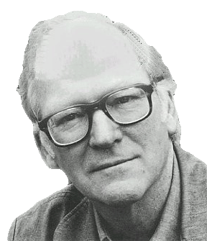
“We are stuck with our two main ways of describing and explaining things, one which treats objects and events as mindless, and the other which treats objects and events as having propositional attitudes. I see no way of bridging the gap by introducing an intermediate vocabulary.”
(Davidson 2003: 697)

Slide 95
“We are stuck with our two main ways of describing and explaining things, one which treats objects and events as mindless, and the other which treats objects and events as having propositional attitudes. I see no way of bridging the gap by introducing an intermediate vocabulary.”
(Davidson 2003: 697)

Slide 97

appendix
What could infants, chimps and scrub-jays represent that would enable them, within limits, to track others’ perceptions, knowledge, beliefs and other propositional attitudes?

Slide 98




Intentional relation
e.g. She is interested in that chocolate
e.g. She is smiling at me
Propositional attitude
e.g. She believes that the chocolate is in that cupboard

Slide 99

Your field = a set of objects related to you by proximity, orientation, lighting and other factors
You encounter an object = it is in your field
You register an object at a location = you most recently encountered the object at that location

Slide 100
Your field = a set of objects related to you by proximity, orientation, lighting and other factors
You encounter an object = it is in your field
You register an object at a location = you most recently encountered the object at that location
proximity
orientation
lighting
barriers
trajectory

Slide 101
Your field = a set of objects related to you by proximity, orientation, lighting and other factors
You encounter an object = it is in your field
You register an object at a location = you most recently encountered the object at that location
proximity
orientation
lighting
barriers
trajectory

Slide 102
Your field = a set of objects related to you by proximity, orientation, lighting and other factors
You encounter an object = it is in your field
You register an object at a location = you most recently encountered the object at that location
Principle 1: one can’t goal-directedly act on an object unless one has encountered it.
Principle 2: correct registration is a condition of successful action.
Principle 3: when an agent performs a goal-directed action and the goal specifies an object, the agent will act as if the object were actually in the location she registers it at.
proximity
orientation
lighting
barriers
trajectory

Slide 103
Your field = a set of objects related to you by proximity, orientation, lighting and other factors
You encounter an object = it is in your field
You register an object at a location = you most recently encountered the object at that location
Principle 1: one can’t goal-directedly act on an object unless one has encountered it.
Principle 2: correct registration is a condition of successful action.
Principle 3: when an agent performs a goal-directed action and the goal specifies an object, the agent will act as if the object were actually in the location she registers it at.
proximity
orientation
lighting
barriers
trajectory

Slide 104
Your field = a set of objects related to you by proximity, orientation, lighting and other factors
You encounter an object = it is in your field
You register an object at a location = you most recently encountered the object at that location
Principle 1: one can’t goal-directedly act on an object unless one has encountered it.
Principle 2: correct registration is a condition of successful action.
Principle 3: when an agent performs a goal-directed action and the goal specifies an object, the agent will act as if the object were actually in the location she registers it at.
proximity
orientation
lighting
barriers
trajectory

Slide 105
Your field = a set of objects related to you by proximity, orientation, lighting and other factors
You encounter an object = it is in your field
You register an object at a location = you most recently encountered the object at that location
Principle 1: one can’t goal-directedly act on an object unless one has encountered it.
Principle 2: correct registration is a condition of successful action.
Principle 3
proximity
orientation
lighting
barriers
trajectory

Slide 106
Your field = a set of objects related to you by proximity, orientation, lighting and other factors
You encounter an object = it is in your field
You register an object at a location = you most recently encountered the object at that location
Principle 1: one can’t goal-directedly act on an object unless one has encountered it.
Principle 2: correct registration is a condition of successful action.
Principle 3: when an agent performs a goal-directed action and the goal specifies an object, the agent will act as if the object were actually in the location she registers it at.
proximity
orientation
lighting
barriers
trajectory

Slide 107

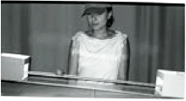
source Träuble, Marinovic, & Pauen (2010)

Slide 108
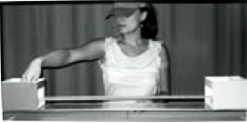
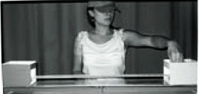
source Träuble, Marinovic, & Pauen (2010)

Slide 109
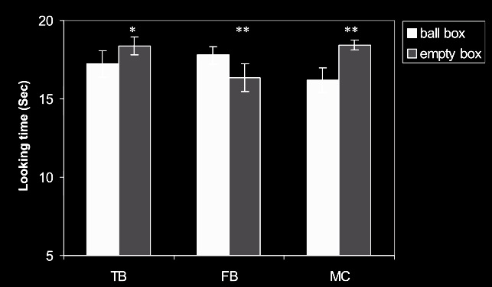
source Träuble, Marinovic, & Pauen (2010)

Slide 110
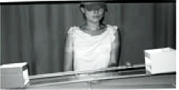
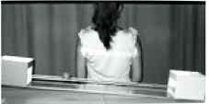
source Träuble, Marinovic, & Pauen (2010)

Slide 111
source Träuble, Marinovic, & Pauen (2010)

Slide 112
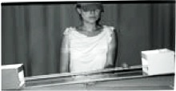
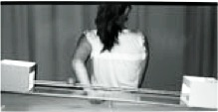
source Träuble, Marinovic, & Pauen (2010)

Slide 113
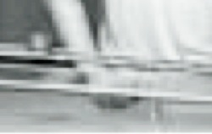
source Träuble, Marinovic, & Pauen (2010)

Slide 114
source Träuble, Marinovic, & Pauen (2010)

Slide 115
Your field = a set of objects related to you by proximity, orientation, lighting and other factors
You encounter an object = it is in your field
You register an object at a location = you most recently encountered the object at that location
Principle 1: one can’t goal-directedly act on an object unless one has encountered it.
Principle 2: correct registration is a condition of successful action.
Principle 3: when an agent performs a goal-directed action and the goal specifies an object, the agent will act as if the object were actually in the location she registers it at.
proximity
orientation
lighting
barriers
trajectory

Slide 116
Your field = a set of objects related to you by proximity, orientation, lighting and other factors
You encounter an object = it is in your field
You register an object at a location = you most recently encountered the object at that location
Principle 1: one can’t goal-directedly act on an object unless one has encountered it.
Principle 2: correct registration is a condition of successful action.
Principle 3: when an agent performs a goal-directed action and the goal specifies an object, the agent will act as if the object were actually in the location she registers it at.
proximity
orientation
lighting
barriers
trajectory

Slide 117
Principle 2: correct registration is a condition of successful action.
source Träuble, Marinovic, & Pauen (2010)

Slide 118
signature limits

Slide 119
1. Charly is Samantha
2. Mitch believes that Charly is in Baltimore
3. Mitch believes that Samantha is in Baltimore
(1) & (2) ⇒ (3)

Slide 120
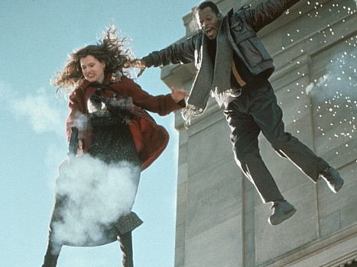
1. Charly is Samantha
2. Mitch believes that Charly is in Baltimore
3. Mitch believes that Samantha is in Baltimore
(1) & (2) ⇒ (3)

Slide 121
1. Charly is Samantha
2. Mitch believes that Charly is in Baltimore
3. Mitch believes that Samantha is in Baltimore
(1) & (2) ⇒ (3)
4. Mitch registers <Charly, Baltimore>
5. Mitch registers <Samantha, Baltimore>
(1) & (4) ⇒ (5)

Slide 122
False belief about location
False belief about identity
Subjects represent registration
Subjects represent beliefs
pass
fail
pass
pass

Slide 123
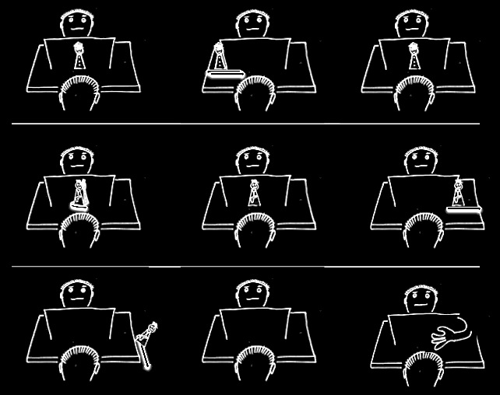

Slide 128
Which Joint Actions
Ground Social Cognition?
s.butterfill@warwick.ac.uk

Slide 129
Theory of mind abilities are widespread

Slide 130
Theory of mind abilities are widespread
18-month-olds point to inform, and predict actions based on false beliefs
(Liszkowski et al 2006)
(Onishi & Baillargeon 2005; Southgate et al 2007)

Slide 131
Theory of mind abilities are widespread
18-month-olds point to inform, and predict actions based on false beliefs
Scrub-jays selectively re-cache their food in ways that deprive competitors of knowledge of its location
(Liszkowski et al 2006)
(Onishi & Baillargeon 2005; Southgate et al 2007)
(Clayton, Dally & Emery 2007)

Slide 132
Theory of mind abilities are widespread
18-month-olds point to inform, and predict actions based on false beliefs
Scrub-jays selectively re-cache their food in ways that deprive competitors of knowledge of its location
Chimpanzees conceal their approach from a competitor’s view, and act in ways that are optimal given what another has seen
(Liszkowski et al 2006)
(Onishi & Baillargeon 2005; Southgate et al 2007)
(Clayton, Dally & Emery 2007)
(Hare, Call & Tomasello 2006)
(Hare, Call & Tomasello 2001)

Slide 133
Theory of mind abilities are widespread
18-month-olds point to inform, and predict actions based on false beliefs
Scrub-jays selectively re-cache their food in ways that deprive competitors of knowledge of its location
Chimpanzees conceal their approach from a competitor’s view, and act in ways that are optimal given what another has seen
(Liszkowski et al 2006)
(Onishi & Baillargeon 2005; Southgate et al 2007)
(Clayton, Dally & Emery 2007)
(Hare, Call & Tomasello 2006)
(Hare, Call & Tomasello 2001)

Slide 134
Theory of mind abilities are widespread
18-month-olds point to inform, and predict actions based on false beliefs
Scrub-jays selectively re-cache their food in ways that deprive competitors of knowledge of its location
Chimpanzees conceal their approach from a competitor’s view, and act in ways that are optimal given what another has seen
(Liszkowski et al 2006)
(Onishi & Baillargeon 2005; Southgate et al 2007)
(Clayton, Dally & Emery 2007)
(Hare, Call & Tomasello 2006)
(Hare, Call & Tomasello 2001)

Slide 135
Theory of mind abilities are widespread
18-month-olds point to inform, and predict actions based on false beliefs
Scrub-jays selectively re-cache their food in ways that deprive competitors of knowledge of its location
Chimpanzees conceal their approach from a competitor’s view, and act in ways that are optimal given what another has seen
(Liszkowski et al 2006)
(Onishi & Baillargeon 2005; Southgate et al 2007)
What doinfants, chimps and scrub-jays represent that enables them, within limits, to track others’ perceptions, knowledge, beliefs and other propositional attitudes?
(Clayton, Dally & Emery 2007)
(Hare, Call & Tomasello 2006)
(Hare, Call & Tomasello 2001)

Slide 136
Theory of mind abilities are widespread
18-month-olds point to inform, and predict actions based on false beliefs
Scrub-jays selectively re-cache their food in ways that deprive competitors of knowledge of its location
Chimpanzees conceal their approach from a competitor’s view, and act in ways that are optimal given what another has seen
Representing perceptions, knowledge states and beliefs is hard

Slide 137
Theory of mind abilities are widespread
18-month-olds point to inform, and predict actions based on false beliefs
Scrub-jays selectively re-cache their food in ways that deprive competitors of knowledge of its location
Chimpanzees conceal their approach from a competitor’s view, and act in ways that are optimal given what another has seen
Representing perceptions, knowledge states and beliefs is hard, for it requires
(a) conceptual sophistication
- takes years to develop
- development tied to acquisition of executive function and language
- development facilitated by training and siblings

Slide 138
Theory of mind abilities are widespread
18-month-olds point to inform, and predict actions based on false beliefs
Scrub-jays selectively re-cache their food in ways that deprive competitors of knowledge of its location
Chimpanzees conceal their approach from a competitor’s view, and act in ways that are optimal given what another has seen
Representing perceptions, knowledge states and beliefs is hard, for it requires
(a) conceptual sophistication
- takes years to develop
- development tied to acquisition of executive function and language
- development facilitated by training and siblings
(b) scarce cognitive resources
- attention
- working memory

Slide 139
Theory of mind abilities are widespread
18-month-olds point to inform, and predict actions based on false beliefs
Scrub-jays selectively re-cache their food in ways that deprive competitors of knowledge of its location
Chimpanzees conceal their approach from a competitor’s view, and act in ways that are optimal given what another has seen
Representing perceptions, knowledge states and beliefs is hard, for it requires
(a) conceptual sophistication
- takes years to develop
- development tied to acquisition of executive function and language
- development facilitated by training and siblings
(b) scarce cognitive resources
- attention
- working memory

